Slide 1
INDEXING

Slide 2
Overview
Three main techniques
  Conventional indexes
    Think of a page table, …
  B and B+ trees
    Perform better when records are constantly added or deleted
  Hashing

Slide 3
Conventional indexes

Slide 4
Indexes
A database index is a data structure that improves the speed of data retrieval operations on a database table at the cost of additional writes and storage space to maintain the index data structure.
Wikipedia

Slide 5
Types of indexes
An index can be
  Sparse
    One entry per data block
    Identifies the first record of the block
    Requires data to be sorted
  Dense
    One entry per record
    Data do not have to be sorted

Slide 6
Respective advantages
Sparse
    Occupy much less space
    Can keep more of it in main memory
      Faster access
  Dense
    Can tell if a given record exists without accessing the file
    Do not require data to be sorted

Slide 7
Indexes based on primary keys
Each key value corresponds to a specific record
Two cases to consider:
  Table is sorted on its primary key
    Can use a sparse index
  Table is either non-sorted or sorted on another field
    Must use a dense index

Slide 8
Sparse Index
Alan
.
Ahmed
…
…
Dana
.
Amita
…
…
Gina
.
Brenda
…
…
Carlos
…
…
Dana
…
…
Dino
…
…
Emily
…
…
Frank
…
…

Slide 9
Dense Index
Ahmed
Ahmed
…
…
Amita
Frank
…
…
Brenda
Brenda
…
…
Carlos
Dana
…
…
Dana
Dino
Emily
…
…
Emily
Dino
…
…
Frank
Carlos
…
…
Amita
…
…

Slide 10
Indexes based on other fields
Each key value may correspond to more than one record
  clustering index
Two cases to consider:
  Table is sorted on the field
    Can use a sparse index
  Table is either non-sorted or sorted on another field
    Must use a dense index

Slide 11
Sparse clustering index
Austin
.
Ahmed
Austin
…
Dallas
.
Frank
Austin
…
Laredo
.
Brenda
Austin
…
Dana
Dallas
…
Emily
Dallas
…
Dino
Dallas
…
Carlos
Laredo
…
Amita
Laredo
…

Slide 12
Dense clustering index
Austin
Ahmed
Austin
…
Austin
Amita
Laredo
…
Austin
Brenda
Austin
…
Dallas
Carlos
Laredo
…
Dallas
Dallas
Dana
Dallas
…
Laredo
Dino
Dallas
…
Laredo
Emily
Dallas
…
Frank
Austin
…

Slide 13
Another realization
Austin
Ahmed
Austin
…
Dallas
.
Amita
Laredo
…
Laredo
.
Brenda
Austin
…
Carlos
Laredo
…
Dana
Dallas
…
We save space
and add one extra
level of indirection
Dino
Dallas
…
Emily
Dallas
…
Frank
Austin
…

Slide 14
A side comment
"We can solve any problem by introducing an extra level of indirection, except of course for the problem of too many indirections."
David John Wheeler

Slide 15
Indexing the index
When index is very large, it makes sense to index the index
  Two-level or three-level index
  Index at top level is called master index
    Normally a sparse index

Slide 16
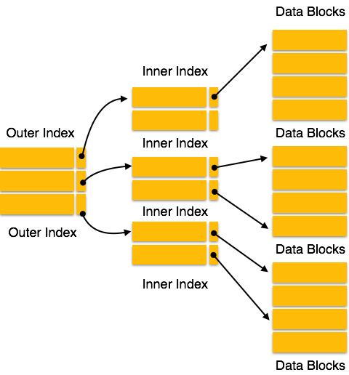
Two levels
AKA
Master Index
Top Index

Slide 17
Updating indexed tables
Can be painful
  No silver bullet

Slide 18
B-trees and B+ trees

Slide 19
Motivation
To have dynamic indexing structures that can evolve when records are added and deleted
  Not the case for static indexes
    Would have to be completely rebuilt
Optimized for searches on block devices
Both B trees and B+ trees are not binary
  Objective is to increase branching factor (degree or fan-out) to reduce the number of device accesses

Slide 20
Binary vs. higher-order tree
Binary trees:
  Designed for in-memory searches
  Try to minimize the number of memory accesses
Higher-order trees:
  Designed for searching data on block devices
  Try to minimize the number of device accesses
    Searching within a block is cheap!

Slide 21
B trees
Generalization of binary search trees
  Not binary trees
  The B stands for Bayer (or Boeing)
Designed for searching data stored on block-oriented devices

Slide 22
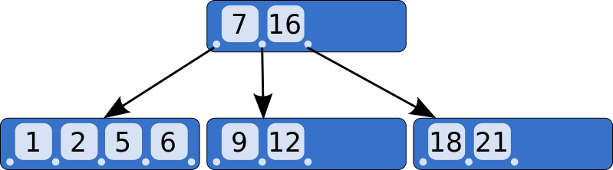
A very small B tree
Bottom nodes are leaf nodes: all their pointers are NULL

Slide 23
In reality
In
tree
ptr
Key
In
tree
ptr
Key
In
tree
ptr
Key
In
tree
ptr
Key
In
tree
ptr
Data ptr
Data ptr
Data ptr
Data ptr
To
Leaf
7
To
leaf
16
To
Leaf
--
Null
--
Null
Null
Null

Slide 24
Organization
Each non-terminal node can have a variable number of child nodes
  Must all be in a specific key range
  Number of child nodes typically vary between d and 2d
    Will split nodes that would otherwise have contained 2d + 1 child nodes
    Will merge nodes that contain less than d child nodes

Slide 25
Searching the tree
keys < 7
keys > 16
7 < keys < 16

Slide 26
Balancing B trees
Objective is to ensure that all terminals nodes be at the same depth

Slide 27
Insertions
Assume a tree where each node can contain three pointers (non represented)
Step 1:
Step 2:
Step 3:
  Split node in middle
1
1
2
1
2
3
2
1
3

Slide 28
Insertions
Step 4:
Step 5:
  Split
  Move up
2
1
3
4
2
1
3
4
5
2
4
1
3
5

Slide 29
Insertions
Step 6:
Step 7:
2
4
1
3
5
6
2
4
1
3
5
6
7

Slide 30
Step 7 continued
2
4
  Split
  Promote
1
3
6
4
7
2
4
6
1
3
5
7

Slide 31
Step 7 continued
Split after
the promotion
2
4
6
1
3
5
7
4
2
6
1
3
5
7

Slide 32
Two basic operations
5
6
7
Split:
  When trying to add to a full node
  Split node at central value
Promote:
  Must insert root of split
  node higher up
  May require a new split
6
5
7

Slide 33
B+ trees
Variant of B trees
Two types of nodes
  Internal nodes have no data pointers
  Leaf nodes have no in-tree pointers
    Were all null!

Slide 34
B+ tree nodes
In
tree
ptr
Key
In
tree
ptr
Key
In
tree
ptr
Key
In
tree
ptr
Key
In
tree
ptr
Key
In
tree
ptr
Key
Key
Key
Key
Key
Key
Data ptr
Data ptr
Data ptr
Data ptr
Data ptr
Data ptr

Slide 35
More about internal nodes
Consist of n -1 key values K₁, K₂, …, K_{n-1} ,and n tree pointers P₁, P₂, …, P_{n} :
  < P₁,K₁, P₂, K₂, P₃, …, P_{n-1}, K_{n-1,}, P_{n}>
The keys are ordered K₁ < K₂ < … < K_{n-1}
For each tree value X in the subtree pointed at by tree pointer P_{i}, we have:
  X > K_{i-1} for 1 ≤ i ≤ n
  X ≤ K_{i} for 1 ≤ i ≤ n - 1

Slide 36
Warning
Other authors assume that
  For each tree value X in the subtree pointed at by tree pointer P_{i}, we have:
    X ≥ K_{i-1} for 1 ≤ i ≤ n
    X < K_{i} for 1 ≤ i ≤ n - 1
Changes the key value that is promoted when an internal node is split

Slide 37
Advantages
Removing unneeded pointers allows to pack more keys in each node
  Higher fan-out for a given node size
    Normally one block
Having all keys present in the leaf nodes allows us to build a linked list of all keys

Slide 38
Properties
If m is the order of the tree
  Every internal node has at most m children.
  Every internal node (except root) has at least ⌈m ⁄ 2⌉ children.
  The root has at least two children if it is not a leaf node.
  Every leaf has at most m − 1 keys
  An internal node with k children has k − 1 keys.
  All leaves appear in the same level

Slide 39
Best cases and worst cases
A B+ tree of degree m and height h will store
  At most m^{h – 1}(m – 1) = m^{h} – m records
  At least 2⌈m ⁄ 2⌉^{h – 1} records

Slide 40
Searches
def search (k) :
return tree_search (k, root)

Slide 41
Searches
def tree_search (k, node) :
if node is a leaf :
return node
elif k < k_0 :
return tree_search(k, p_0)
…
elif k_i ≤ k < k_{i+1}
return tree_search(k, p_{i+1})
…
elif k_d ≤ k
return tree_search(k, p_{d+1});

Slide 42
Insertions
def insert (entry) :
  Find target leaf L
  if L has less than m – 2 entries :
    add the entry
  else :
    Allocate new leaf L'
    Pick the m/2 highest keys of L and move them to L'
    Insert highest key of L and corresponding address leaf into the parent node
    If the parent is full :
      Split it and add the middle key to its parent node
    Repeat until a parent is found that is not full

Slide 43
Deletions
def delete (record) :
  Locate target leaf and remove the entry
  If leaf is less than half full:
    Try to re-distribute, taking from sibling (adjacent node with same parent)
    If re-distribution fails:
      Merge leaf and sibling
      Delete entry to one of the two merged leaves
      Merge could propagate to root

Slide 44
Insertions
Assume a B+ tree of degree 3
Step 1:
Step 2:
Step 3:
  Split node in middle
1
1
2
1
2
3
2
1
2
3

Slide 45
Insertions
Step 4:
Step 5:
  Split
  Move up
2
1
2
3
4
2
1
2
3
4
5
2
4
1
2
3
4
5

Slide 46
Insertions
Step 6:
Step 7:
2
4
1
2
3
4
5
6
2
4
1
2
3
4
5
6
7

Slide 47
Step 7 continued
2
4
  Split
  Promote
1
2
3
4
6
5
6
7
2
4
6
1
2
3
4
5
6
7

Slide 48
Step 7 continued
Split after
the promotion
2
4
6
1
3
5
7
4
2
6
1
3
5
7

Slide 49
Importance
B+ trees are used by
  NTFS, ReiserFS, NSS, XFS, JFS, ReFS, and BFS file systems for metadata indexing
  BFS for storing directories.
  IBM DB2, Informix, Microsoft SQL Server, Oracle 8, Sybase ASE, and SQLite for table indexes

Slide 50
An interesting variant
Not on
Spring 2015
first quiz
Can simplify entry deletion by never merging nodes that have less than ⌈m ⁄ 2⌉ entries
Wait instead until there are empty and can be deleted
Requires more space
Seems to be a reasonable tradeoff assuming random insertions and deletions

Slide 51
Multi-key indexes
Not part of ADSA course

